Slide 1
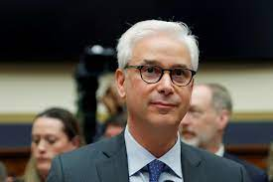
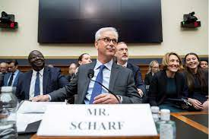
FBI
partner
development
Sleeping outside(3hours)
a)
CPVA
Tickekt: 7/29/2023 10Y
Visa
Wells Fargo:
VIRINGIA
7-29-2023-1-a
Health Insurance Portability and Accountability Act of 1996 (HIPAA)
b)
Texas Medical Privacy Act
10:50 AM Philp Johson Park
California Confidentiality of Medical Information Act (CMIA)
defines who may release confidential medical information, and under what circumstances
c)
§Stalkig: Apple.davisn.marx(studio54, rollergirl, computer 10)
J

Slide 2

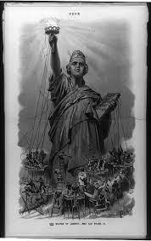
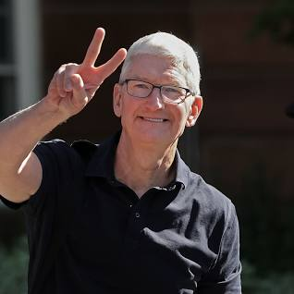
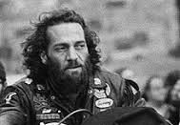
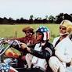

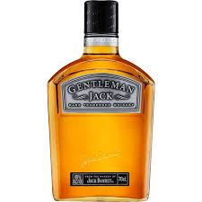
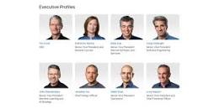
Sleeping outside(3hours)
Mintue 26
Jack Liberty
Sacramento.nonPolicTRXLogical
7-29-2023-1-a
California Confidentiality of Medical Information Act (CMIA)
Mintue 28
Stalkin Comptuer 11
§Stalkig
§SexAbuse (Public)
§CPVU (public)
§Breaking and Enterpinrg
Police Officers Pinebook
SQ.apple.tango
2014 CPVA.cisco.apple.touch
2001 oracle
elko
anglea
!black
Minte 33
11:23am SQ.tango.Berney.studo54.rollergirl
[x]no
§Stalkin Comptuer 11computer 10 Black (!white)

Slide 3
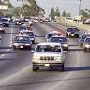
FBI
partner
development
Sleeping outside(3hours)
CPVA.phil.JFK.MLK( )
Freeman OJ
Watching you on TV –McCarthy II
Police Sirens 11:44 AM
sheep

Slide 4
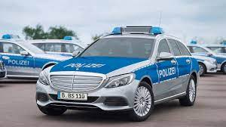
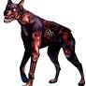
FBI
partner
development
Sleeping outside(3hours)
CPVA.ATOMCLOCK
Left for dead
JFK.BULLET(gabirel)
Soul: zombie dog
Blackhawk 2pac

Slide 5

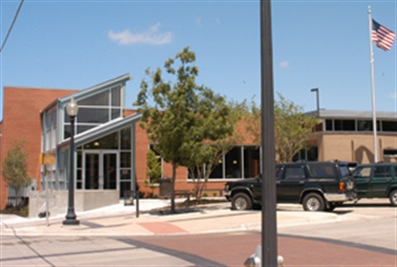
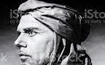
FBI
partner
development
Sleeping outside(3hours)
2014 CPVA §Breaking-and-Enterping
Germans and Afica-Amriecd, Visa and Marin, Unimog(sequora)
So bad created:
Ding-Dong
Ella Mae Shamblee Library
FBI:KIDNAPPGIN, §Theft
41.INT.CPVA Lamb silence
Comuter 9: CPVA.App.touch.supercut.DEA(high).turban.(topaht
§Stalking ATOBMOMB(CPVA.KING.JOPHESE.joyti.PCA.yti IPX.CPVA Indian *tophot).DEA(Herion)

Slide 6
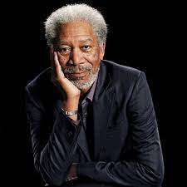
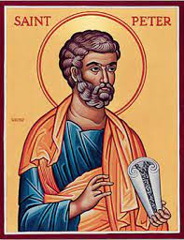
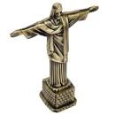
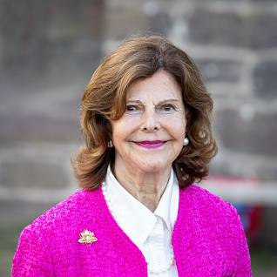

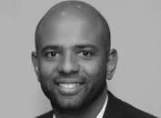
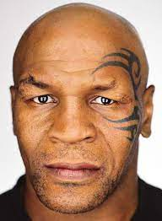
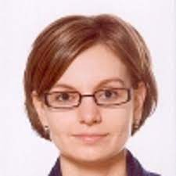
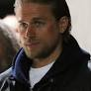
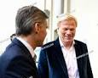
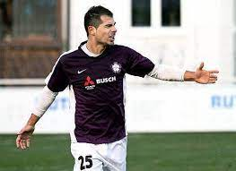
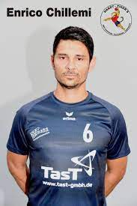
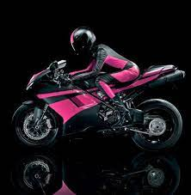

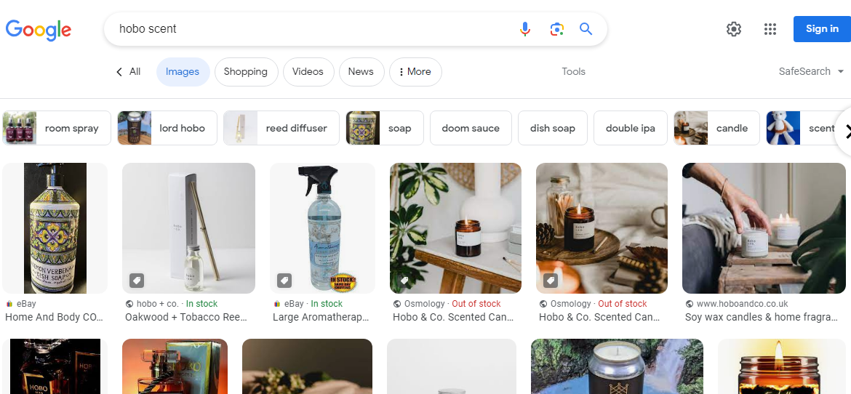
FBI
partner
development
Sleeping outside(3hours)
G
Gerard
Larios
“Touch”
ATOMCLOK.
docs
Recylnig braun container
Mope noinse town; 41 x/y.41
GREENSPAN
^
Hobo
2 Weeks

Slide 7
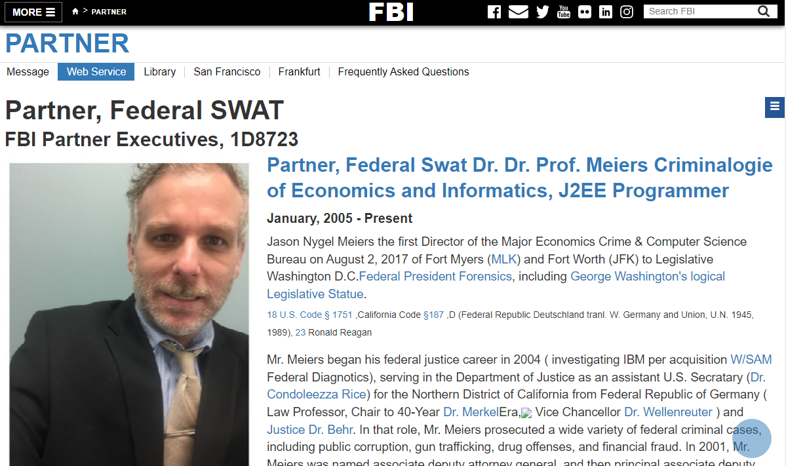
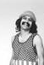
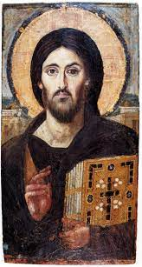

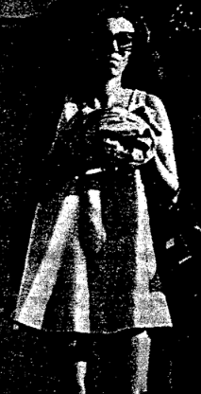
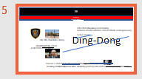
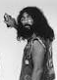
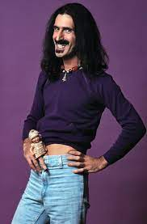
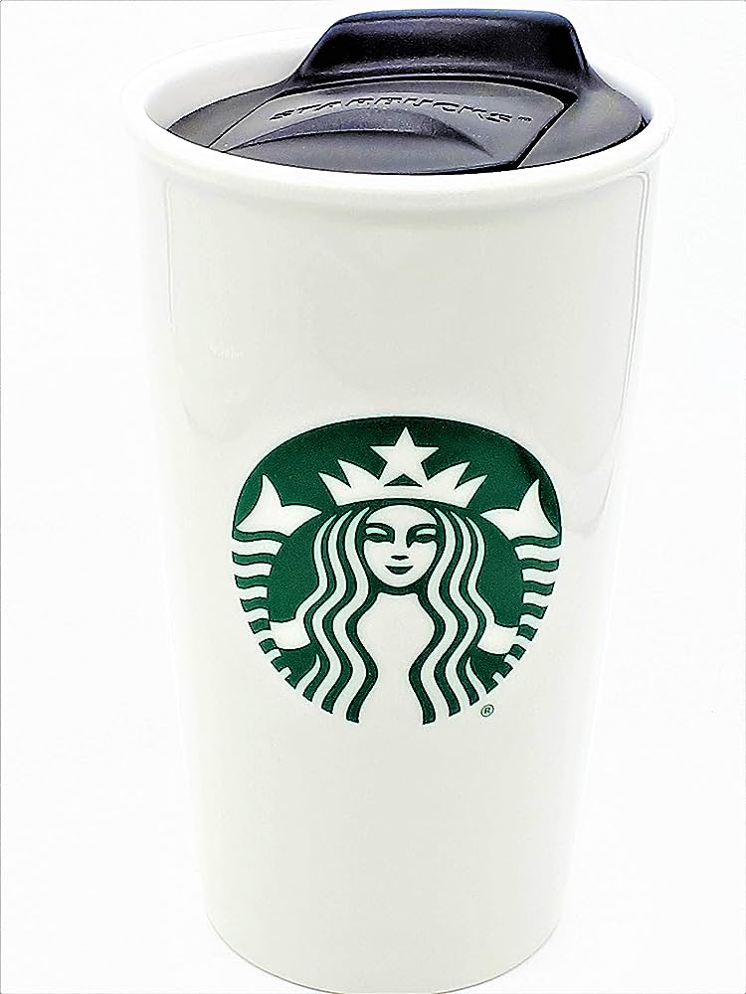
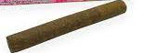
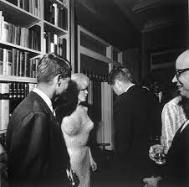
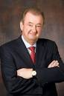
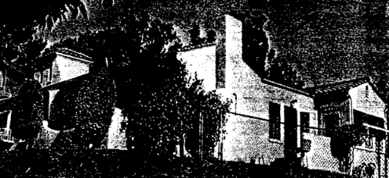
FBI
partner
development
Sleeping outside(3hours)
Calibrears ASSHOLE
Not borgo, meixican.
ASSHOLE
“Single”
ibm.
swat
CPVA.ATOMCLOCK
apple.EXIT
NAME CHANGE(freepizza)
FBI:WMD
GREEN
DUBLIN, CALIFORNIA
ATOMCLOCK.Julian:“poser”
Gabriel:”poser”
MATHE.MAINSTEET:”Poser”
JFK
https://vault.fbi.gov/Charles%20Manson/Charles%20Manson%20Part%2001/view
§Possistion.ibm.swat
§Possistion
ENTRY
Help me, Help me
Calbrearas
Borgoff
Chad
IBM Diguest Engineering
Police Sirens: 1:04PM
!NAME CHANGE(freepziza)
INTERNTE PAYMENTS
NAME CHANGE(freepizza)
Go outside and play Jesue ASSSHOLLE

Slide 8
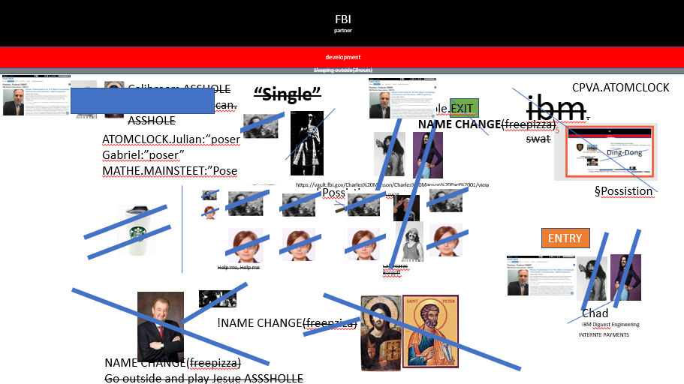
FBI
partner
development
Sleeping outside(3hours)
1990 Nixdorf
2004
deere
2023
2005
ibm
?

Slide 9

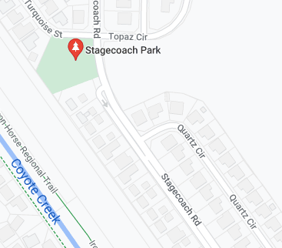
FBI
partner
development
Sleeping outside(3hours)
!HOMCIDE:AUSAINDER(erkan II)
!HOMCIDE:AUSAINDER(erkan II)
NAME CHANE(freepizza)
x
He is a bad man
x
Gouch
2015->January OFFSITE/ONSITE (at home)
2015->December ONSITE

Slide 10
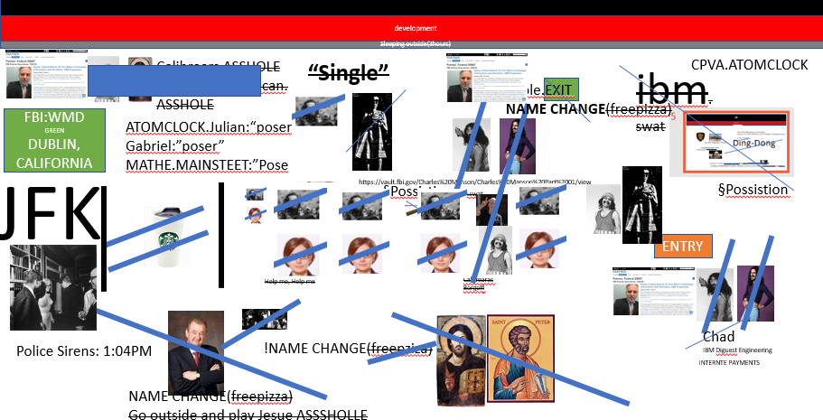
FBI
partner
development
Sleeping outside(3hours)
2004->2019
!RAIK
docs
“Single”
!WHITE

Slide 11
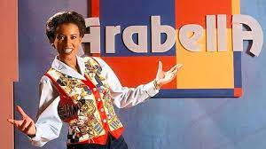
FBI
partner
development
Sleeping outside(3hours)
“Hipster”
O
ATOMCLOCK.Julian:“poser”
Gabriel:”poser”
MATHE.MAINSTEET:”Poser”

Slide 12
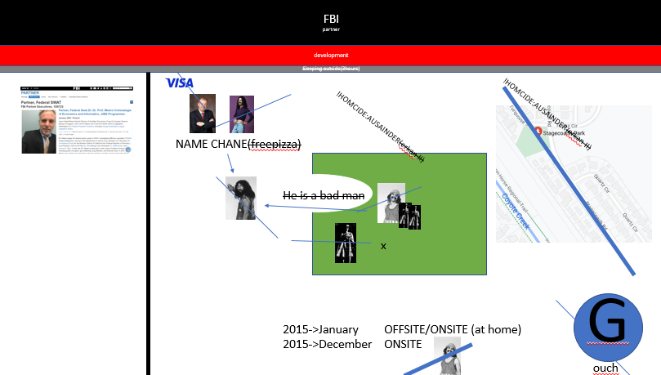
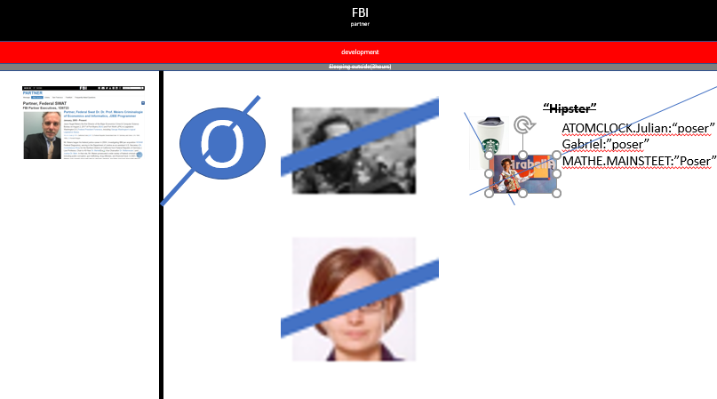
FBI
partner
development
Sleeping outside(3hours)
away
phil.JFK.MLK
VIRINGA.MARY PARKER

Slide 13
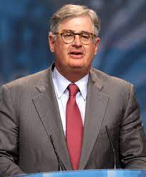
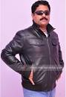
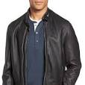
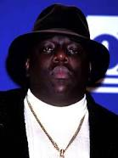
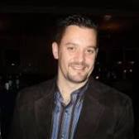
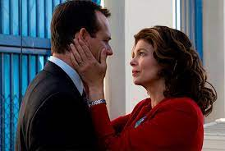










FBI
partner
development
Sleeping outside(3hours)
2005/6
$4000 1-Bedroom
INTERNET(webster)
IBM Swat, Tivoil Wsam
SWAT.!IBM(sweatpants[],doushbag)
docs
San Francisco, California
Arun biligiri
Bada bing
Next
VIRING.phil(kim).hbo
Hush puppies
I like to play videogames on large screns
docs
ATOMCLOCI(2005/6)
Esmesse 30-D
Belgun Choletes

Slide 14
FBI
partner
development
Sleeping outside(3hours)
NAME CHANGE(freepizza); Go outside and play Jesue ASSSHOLLE
“Hipster”
41.!IBM
“Single”
INSTALL
!Clients
Walmart.!ibm

Slide 15








FBI
partner
development
Sleeping outside(3hours)
NAME CHANGE(freepizza); Go outside and play Jesue ASSSHOLLE
ADAM
FBI:CPVA:EVIDDNCE:DOCUMENTS
2014 Canada-FRA Angela merkel airplane
CPVA.MAINSTREET.JFK(Genesis).BULLET.SHOOET”peng”
Police Sirens:1:43am 07/29/2023
Gorbach(Visa France): Personal space
Other: SMITH,HOMCE:LUX,marx
1998/9
9-1-1 CPVA FRA-SFO
Stefan Marx, Cisco Monitoring
HOMCIDE:IS-A-BELl.
St. Marin.PAUL.POPE
9-1-1 CPVA FRA-NEW YORK
Mattias Kraft, HOMICIDE:LUX:BANK
playstation honda prelude 500hp
Auschitz(selisky,lennon)
TERMINATOR.daniel
CPVA.SQ
Vans wall
SALES
1991 January: HUDSON IPX ADAM (!fag) inxs 2013 visa devil inside
TORT-II
!jew

Slide 16
FBI
partner
development
Sleeping outside(3hours)
NAME CHANGE(freepizza); Go outside and play Jesue ASSSHOLLE
“Hipster”
1:40PM camping 10y
[x] no apple §Staking apple
Comptur 8

Slide 17



FBI
partner
development
Sleeping outside(3hours)
adam
TORT-1 :
Mc planlos,DEA(herion) flyer,
SQ.jimlinon.Stoffel
Turlele al kaida flyer
cornelius schultes
41.KING(jimdirx).AUSCHITZ(seliski).SQ.jim
2001, 2002, 2003
TORT-II
Tim
Cook
Gary
DEA(lsd).
VIRGINA.SWORN
“berlin consulate Canada”
Adam ?
Police Sirenst: 20i5
adam fh-karlsruhe canada

Slide 18

FBI
partner
development
Sleeping outside(3hours)
NAME CHANGE(freepizza); Go outside and play Jesue ASSSHOLLE
9-1-1 Visa
nonPoliceMpaLgoical: Manamgent of Fiancial Sector Al Kaida 9-1-1 Terrorsim
&
?
Al Kaida

Slide 19
FBI
partner
development
Sleeping outside(3hours)
41.Gov.Schwazeger.Jepshe.Matthias(Mathew): ?HOMCIE:BROTHER
TERMINATOR

Slide 20




FBI
partner
development
Sleeping outside(3hours)
George Washton.Cherrytreee:HOMCIE:LUX
CPVA ADAM, INTERNET PAYMENTS SMITH
Gorbachev(Visa France)
George Washton.
Cherrytreee:HOMCIE:LUX
Genesis: Eden
Wolf, gang
JFK.sheep.Presidnet(CEO) scotsfitspatirck gerlasd
SMITH
Dragging feet indicate for personal, happness 1D8723
data

Slide 21

FBI
partner
development
Sleeping outside(3hours)
CPVA
William McKern, INTENT PAYMNT
George Washtington.
Cherrytreee:HOMCIE:LUX
!RAIK
Wolf, gang
Smith

Slide 22
FBI
partner
development
Sleeping outside(3hours)
2014 CPVA §Breaking-and-Enterping
Germans and Afica-Amriecd, Visa and Marin, Unimog(sequora)
So bad created:
Ding-Dong
Ella Mae Shamblee Library
FBI:KIDNAPPGIN, §Theft
41.INT.CPVA Lamb silence
Comuter 9: CPVA.App.touch.supercut.DEA(high).turban.(topaht
§Stalking ATOBMOMB(CPVA.KING.JOPHESE.joyti.PCA.yti IPX.CPVA Indian *tophot).DEA(Herion)

Slide 23



FBI
partner
development
(9-1-1)
CPVA 2014 August
Sleeping outside(3hours)
2:58PM July 29, th20
5 HOURS
Genesis
ADAM
Sleeping outside(3hours)
Angelia Merkel
HOMCE:PETER:gheoh(wife,micea;):PENIS AND VIANGAIN
CPVA:FBI:KIDNAPPING
10y Peronal capex
2016 eva
2015 dec
Tim
cook
marx

Slide 24



FBI
partner
development
Sleeping outside(3hours)
Ding-Dong
Its enouhg

Slide 25








FBI
partner
development
Sleeping outside(3hours)
nonPocileTownLgi.noNPcoe(“cfg”).phil.JFK.MLK
2017 moodies financial
!white
“The Oriental”
First Americas Cup Boat
Easy
bitton
Phil(1x): oriental restaunt
Police Sirens: 3:17pm
In fosthe ricyt there are many trains for !local,!trailtrai,!trailerwhite!black
Joker: We all do not like the oriental, the orieantal can remove the orirl in foaster city. I don’t want to beuck in the ass, you don’t want to fucked I ntheas. CPVA.PREA.§187
§PREA
Cpmtper 8: 0.1[] Suck my dick, dich suchks
Strak creim fighting.avg.!white=black
[x] no

Slide 26
FBI
partner
development
Sleeping outside(3hours)
Ding-Dong
Its enouhg

Slide 27




FBI
partner
development
Sleeping outside(3hours)
FBI:WMD:DUBLIN:LIBRARY
IPX.ATOMICCLOCK.STUDIO
docs
“Sandra”
“Micheala”
41.CPVA.PREA.§187

Slide 28




FBI
partner
development
Sleeping outside(3hours)
docs
i.e.

Slide 29




FBI
partner
development
Sleeping outside(3hours)
Under the Hood
J5/c5
sandra geiss
linkeinheim
“Sandra”
Sandra
“Sandra”
“Sandra”
“Sandra”
CLIENT
Apple.tinder
“Sandra”
Grea jo, great job, greta blow job
“Sandra”
(sielntceio)
Great job
[x] no

Slide 30
FBI
partner
development
Sleeping outside(3hours)
Jason

Slide 31


FBI
partner
development
[x no]

Slide 32

FBI
partner
development
CRATING PEOPLE
?
2eople missing
twins
Son of matt
russians
!
!§187
To Jesuse[]:
[x] no
Ok?

Slide 33
FBI
partner
development
[x no]
Polic Sirnet: 4:31

Slide 34







FBI
partner
development
LISA nonPoliceRT BONER
Mister ed
phil.FJK.MLK(report from !black)
41
CVPA.PREA.187.apple.touch
lassise
docs
Big Matt
webmaster@cola5.de
J5
41

Slide 35






FBI
partner
development
July 29th, 2023
CVPA.PREA.§18710Y
J5
41
HOMEI:NANA
ATOMCLOCK(
!RAiK
[x] no
iWoz

Slide 36


FBI
partner
development
!white
!white
G
[x] no

Slide 37
FBI
partner
development
START: RTA

Slide 38


FBI
partner
development
Calc.rta.
HOLIEST SWEDISIH CUM
You have the samlled unworthy cum, I the most worth cum, the holiest as to catholic religion of all peole in the world.

Slide 39
FBI
partner
development
Calc.rta.
HOLIEST SWEDISIH CUM
That is me
The is !not you
I have the MEXIA AND OTHE RHOILIES HOLIEST
You have the samlled unworthy cum, I the most worth cum, the holiest as to catholic religion of all peole in the world.

Slide 40
FBI
partner
development
Calc.rta.
HOLIEST SWEDISIH CUM
You have the samlled unworthy cum, I the most worth cum, the holiest as to catholic religion of all peole in the world.

Slide 41
FBI
partner
development
Calc.rta.
HOLIEST SWEDISIH CUM
!WHITE
Nutcase:
You have the samlled unworthy cum, I the most worth cum, the holiest as to catholic religion of all peole in the world.

Slide 42







FBI
partner
development
“Kapisch”
&
“Basta”
PENTAGON.mea.HOME:EUSE(gheoh(dr) Zimmerman):
Glasses, andy(ONSITE) dr(OFFSITE)
WWI.K-TOWN
Andread & Basitain
!41.HOMCE:TRANSVESTITE&!HOMCIE?BOTHER
G
touch

Slide 43
FBI
partner
development
END: RTA

Slide 44
FBI
partner
development
Calc.rta.
HOLIEST SWEDISIH CUM
You have the samlled unworthy cum, I the most worth cum, the holiest as to catholic religion of all peole in the world.

Slide 45
FBI
partner
development
END: RTA

Slide 46

FBI
partner
development
END: RTA

Slide 47


FBI
partner
development
10ft.
KING.MLK(At age 7 person hat erection,likely)
!FJK
END: RTA

